Slide 1
2013
WELCOME
Vagnerplast Brand is Back
let´s experience the Sanitary ware revolution

Slide 2
INTRODUCTION
We are the first manufacturer of acrylic baths since 1993 in the Czech Republic.
VAGNERPLAST produces acrylic baths and trays for more than 18 years.
During this period of time we have significantly improved the technological production process and thus the quality of our products.
We will again offer a wide range of products for your bathroom, where every customer can choose according to his wishes.
We want to make VAGNERPLAST favorite by bringing again the perfect combination of quality and price of our products

Slide 3
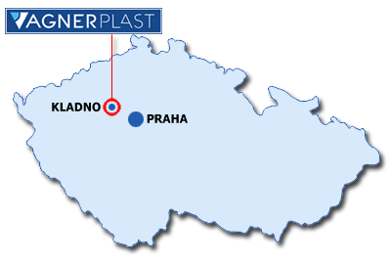
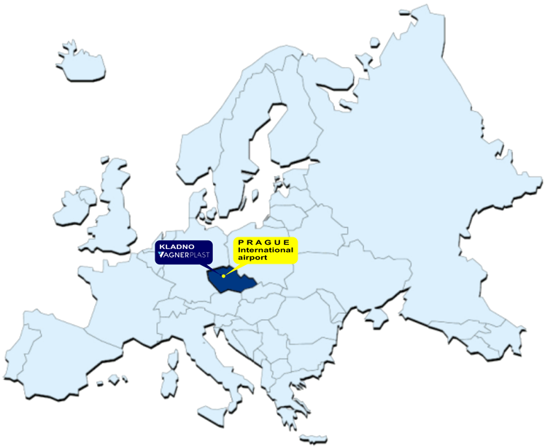
LOCATION
Quick expedition thanks to our location
We are just 10km from Prague international airport
VAGNERPLAST spol. s r.o.
address: Huťská 124 272 01 Kladno Czech Republic phone: +420 312 816 032 fax : +420 312 688 815 e-mail: info@vagnerplast.cz

Slide 4
HISTORY
1993 VAGNERPLAST was founded by Ing. Bořivoj Vágne
2001 VAGNERPLAST was bought by Villeroy & Boch AG and continued to use the VP logo on all products
2007 Villeroy & Boch AG abolished VP logo and started to use GUSTAVSBERG logo on all products
2010 VAGNERPLAST was bought by Ing. Bořivoj Vágner and started again with new product range using the original brand and logo
2010 VAGNERPLAST bought a majority share of the Faucet manufacture company Slezák RAV-CZ
2011 VP bougt the Corralit solid surface company from
mi-pol group and started the production of acrylic mineral stone sheets.

Slide 5
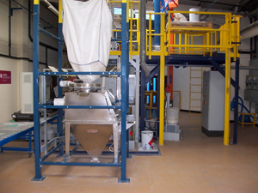
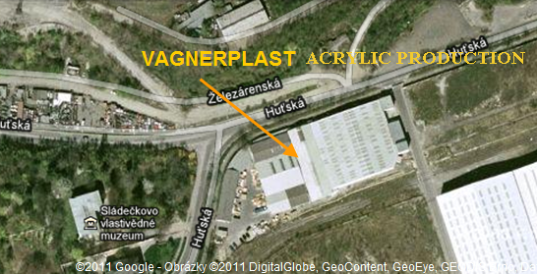
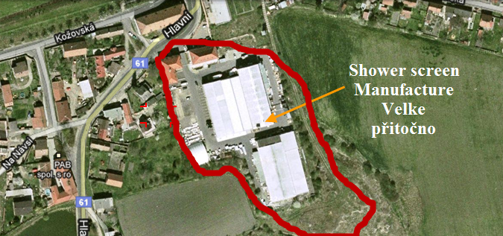
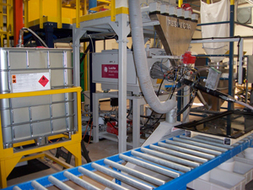
PROFILE
VP is a manufacture of different products: acrylic bathtubs, shower cabins and corralit solid surface
VP is on a surface of 6 500 m²
VP have 35 permenant staff and it can vary.
Our production capacity is around 60 000 bathtubs / year
Our products and production processes are certified and compatible with the ISO 9001
We use ABRA system in our manufacture
We use technology machines with automatic system
Our major cooperator is Villeroy & Boch AG
We export to Europe, Africa and Middle East

Slide 6
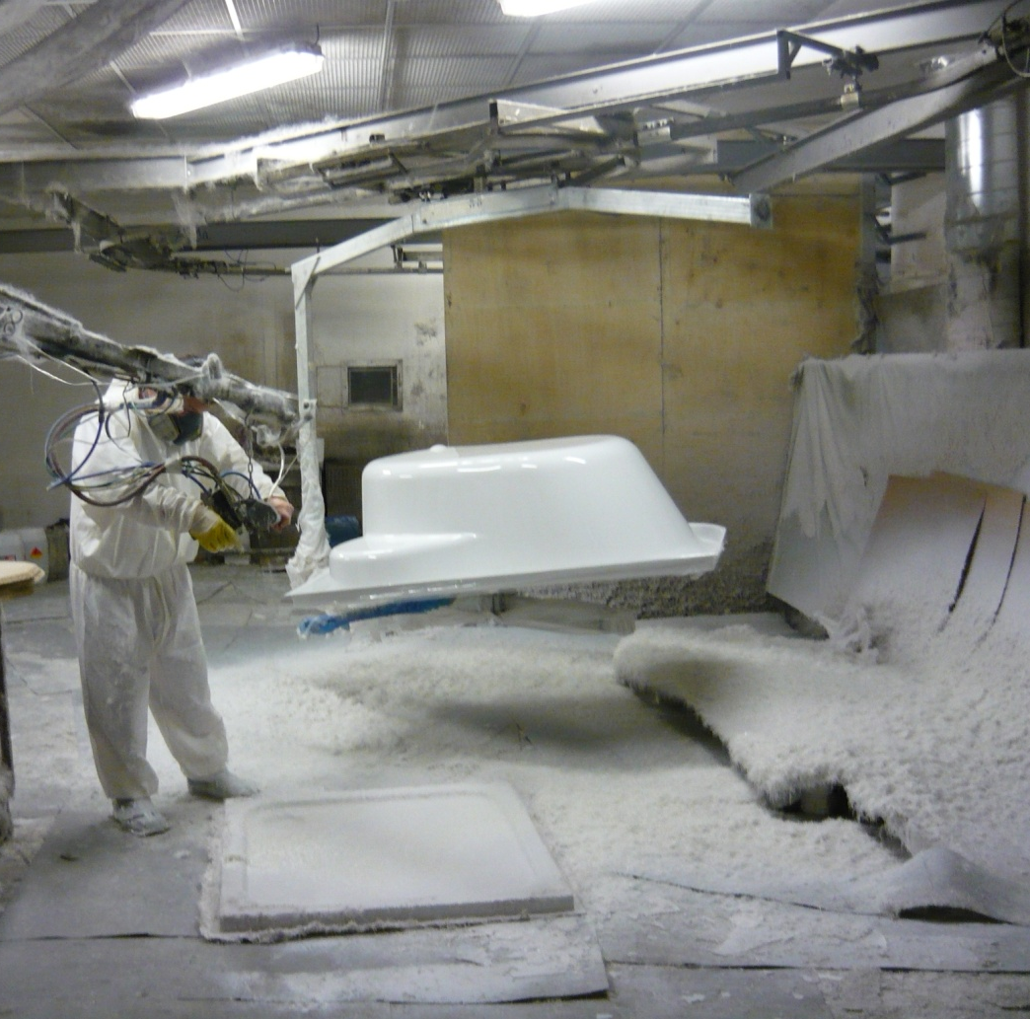
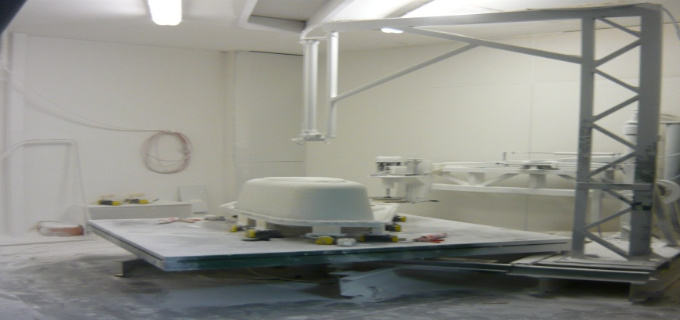
Acrylic Manufacture

Slide 7
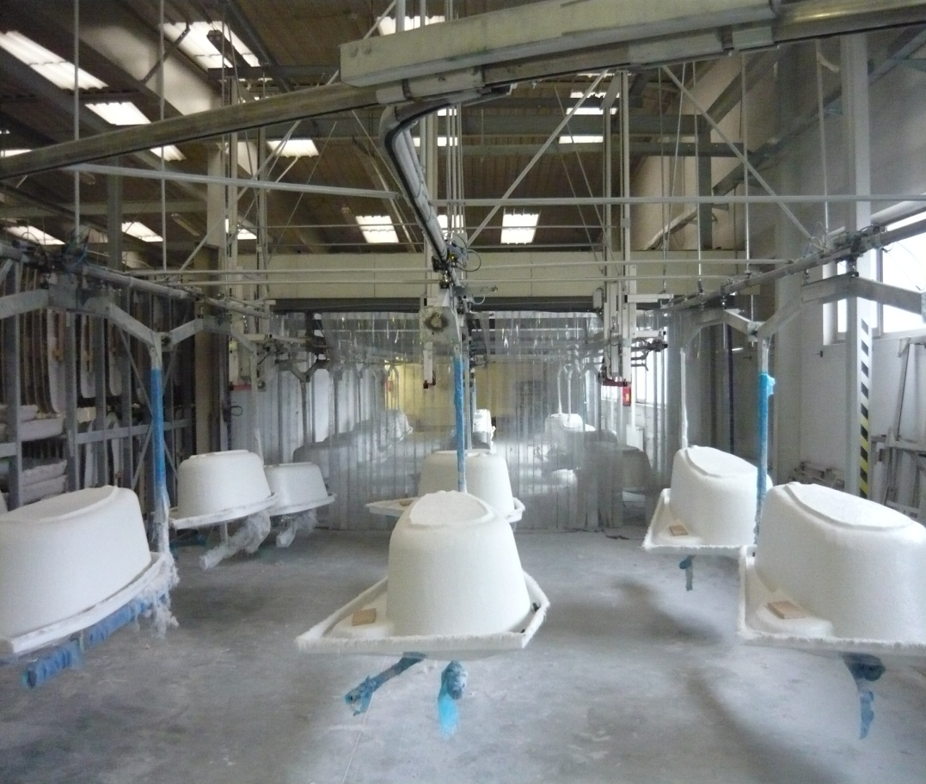

Slide 8
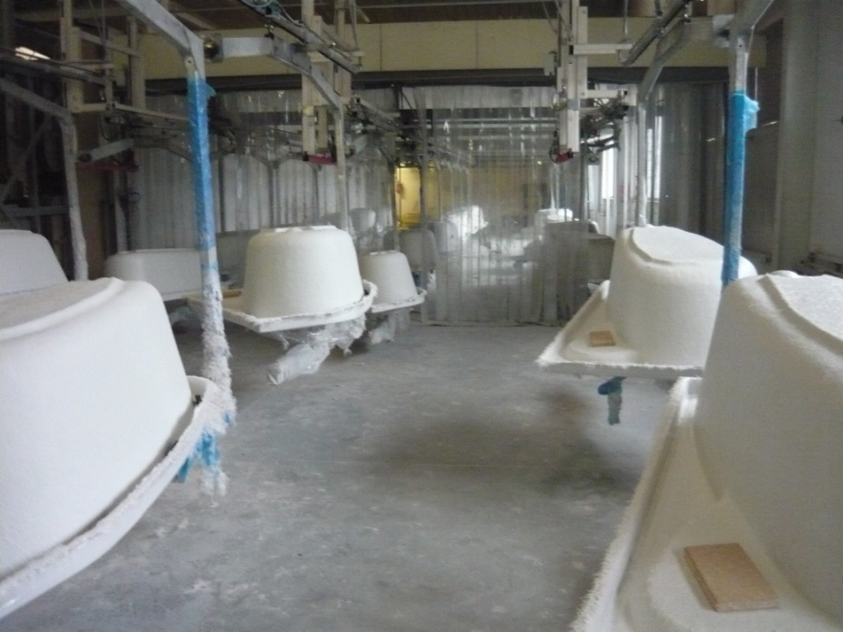
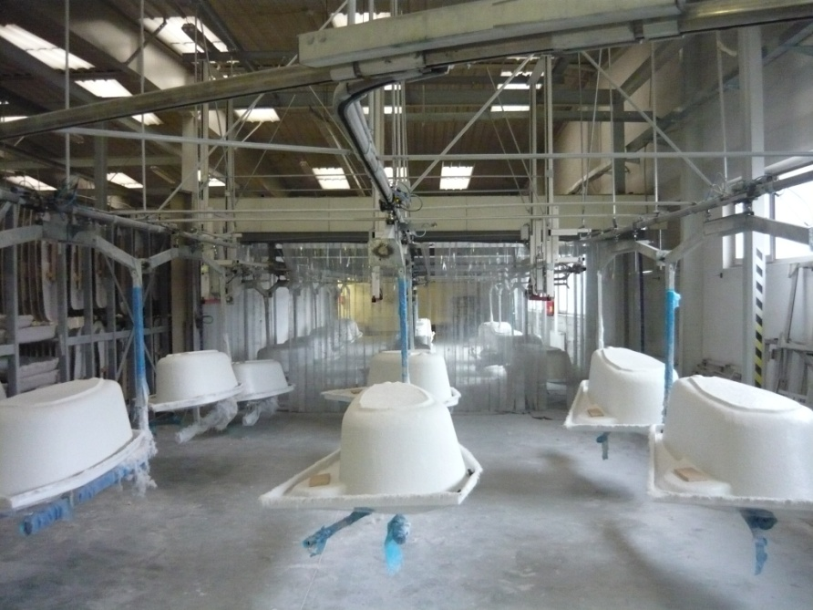

Slide 9
PRODUCT RANGE
PRODUCT RANGE

Slide 10
PRODUCT RANGE
Acrylic Bathtubs
Shower enclosures
Corralit Solid surface
Shower trays
Whirpool systems

Slide 11
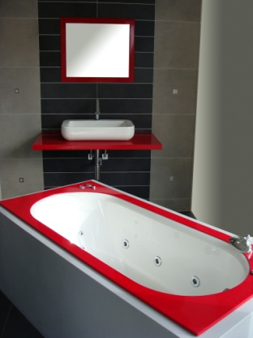
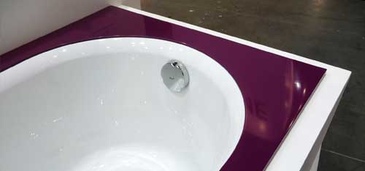
BEST QUALITY
WHAT QUALITY WE OFFER?
Tubs are made from high quality polymetacrylic 4mm Lucite and Altuglas sheets
Regular offered in Euro white color
Tubs with colored Corralit natural stone frames
Feet are part of the bath
Vagnerplast cleaning kit
10 years of warranty
Internationally certificated
Material is fully equipped with full thickness, bright, colorfast, non-porous, it has a high upper strength, chemical resistance and is pleasant to touch

Slide 12
BATHTUBS
New line Cavallo Veronela Briana Ebony Avona Artline Kasandra corralit frame Cavallo corralit frame
Trend line Hera Kasandra Kleopatra Minerva Charitka Selena 160 Flora Melite Iris Paria Gaia Helios
Basic line Nike Nymfa Penelope Selena 147 Athena
Relax line Air Hydro Combi

Slide 13
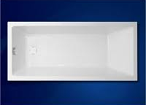
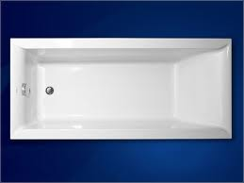
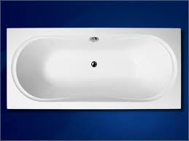
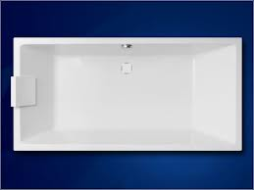
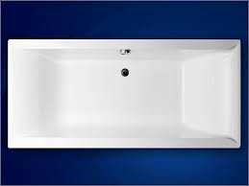
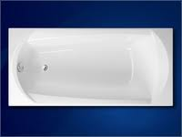
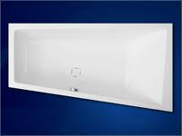
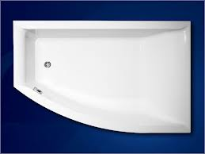
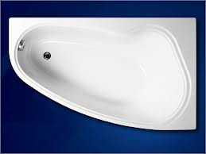
NEW LINE
Cavallo 1500x700,
1600x700,
1700x750
Veronela 1600x700,
1700x750
Briana 1700x750,
1800x800,
1850x900
Cavallo 1800x800,
1900x900
Veronela 1800x800
Ebony 1600x750,
1700x750
Cavallo 1600x900 Left / Right
Veronela 1600x1050 Left / Right
Avona 1500x900 Left / Right

Slide 14
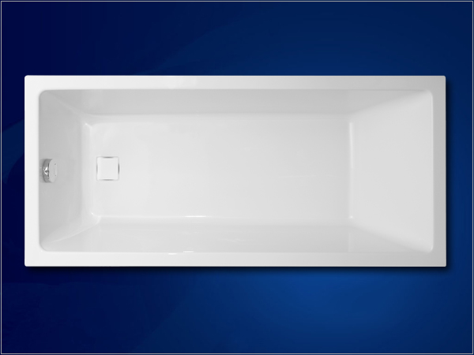
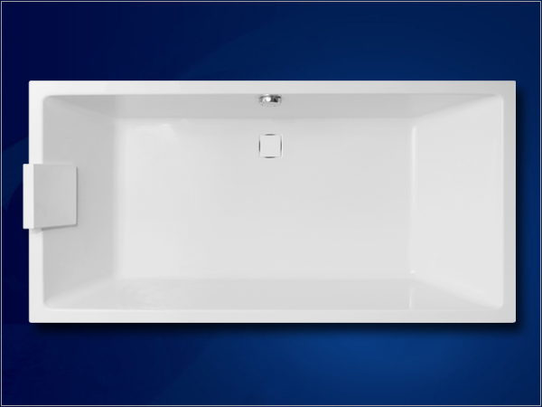
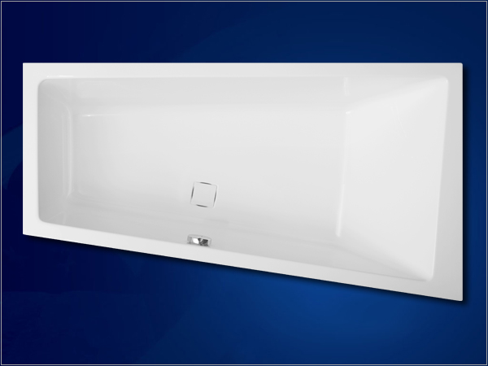
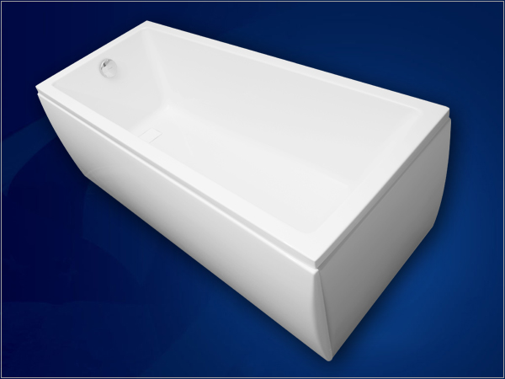
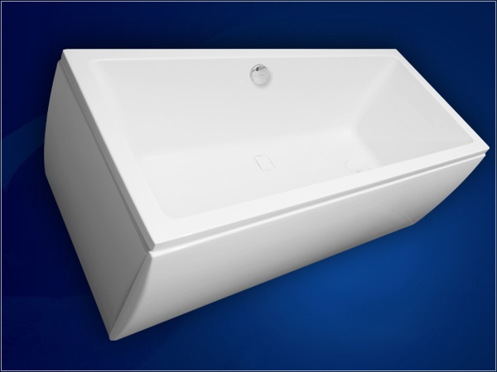
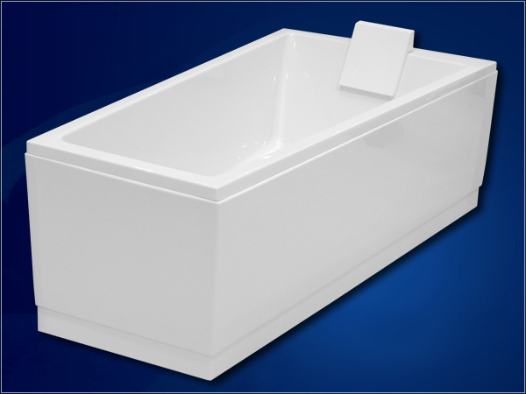
CAVALLO
1500x700, 1600x700, 1700x750
1800x800, 1900x900
1600x900 Left / Right

Slide 15
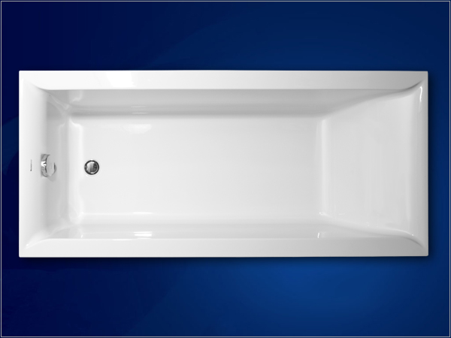
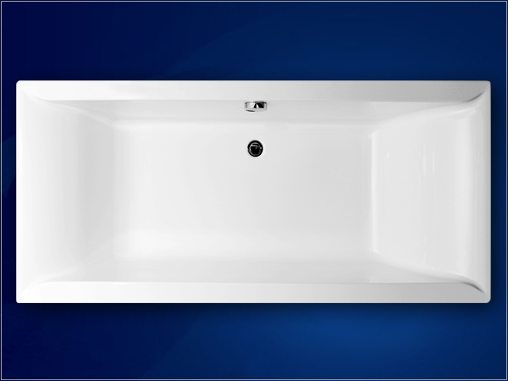
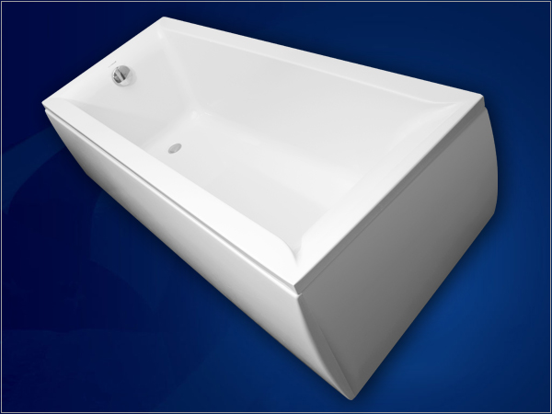
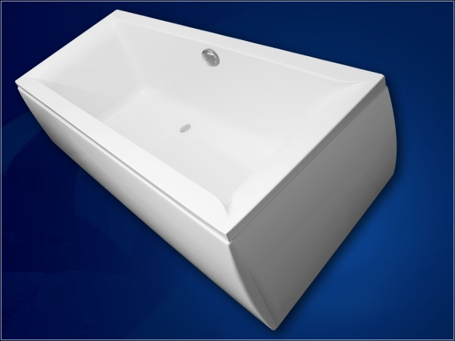
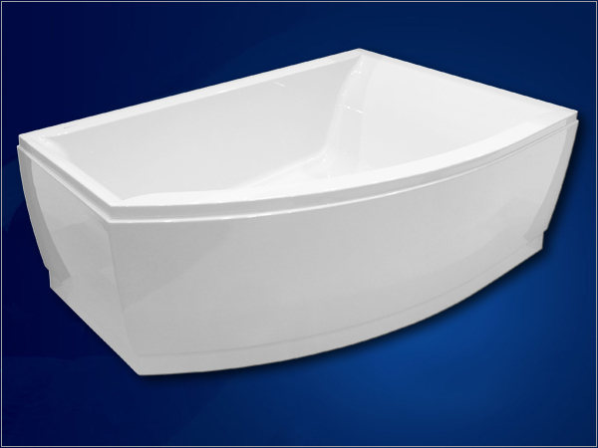
VERONELA
1600x700, 1700x750
1800x800
1600x1050 Left / Right

Slide 16
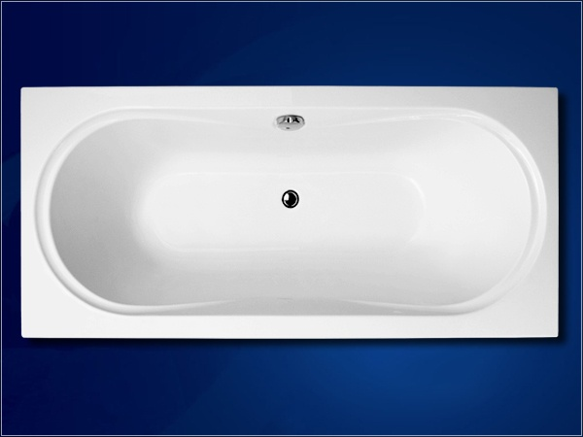
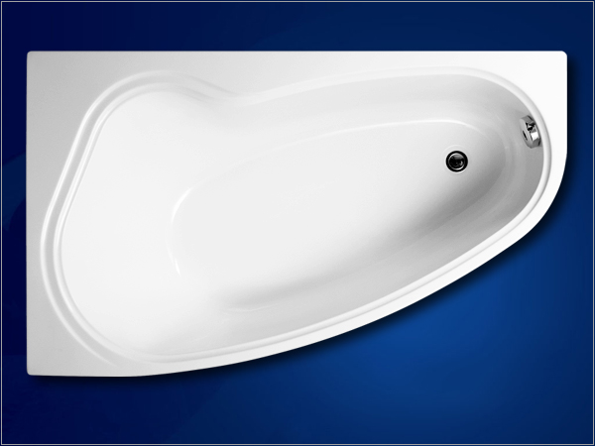
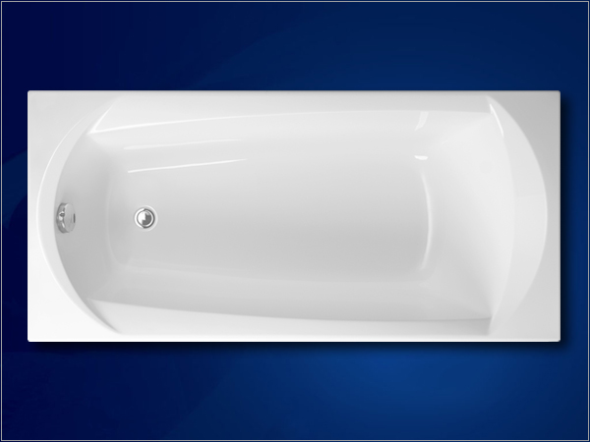
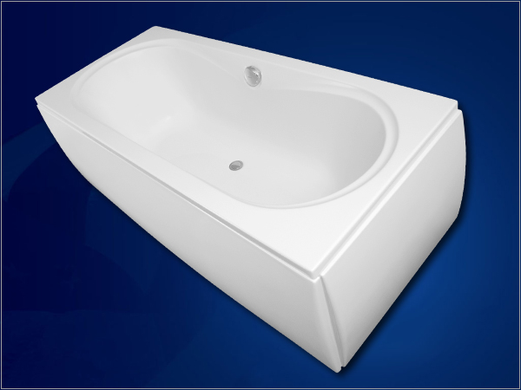
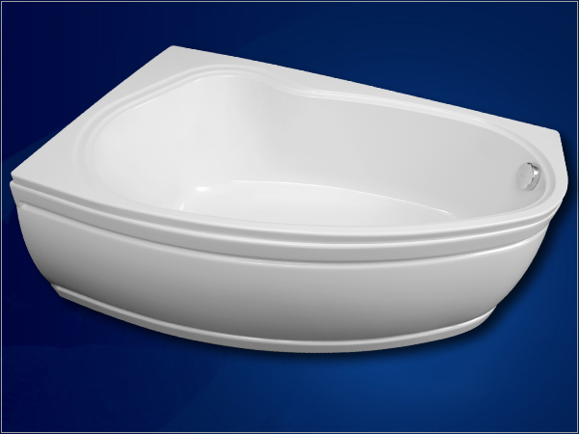
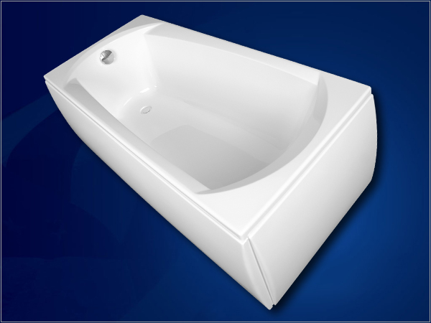
BRIANA
AVONA
EBONY
1700x750, 1800x800, 1850x900
1500x900 Left / Right
1600x750, 1700x750

Slide 17
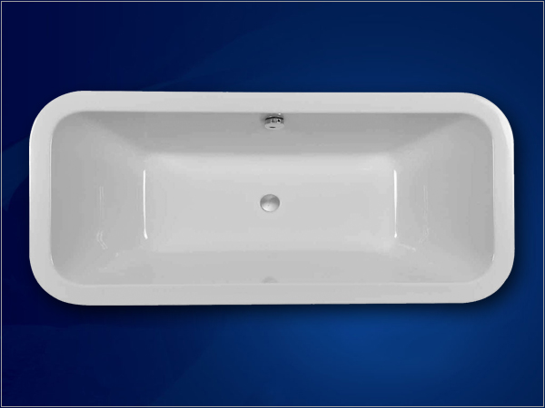
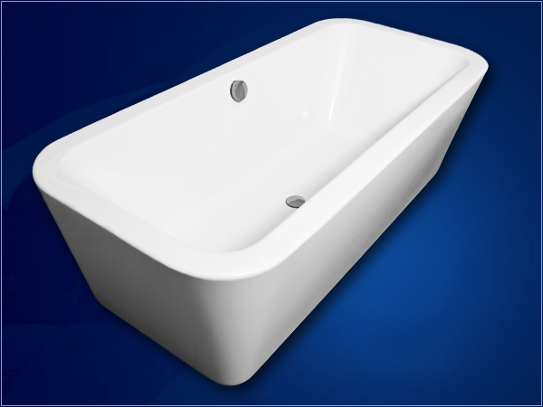
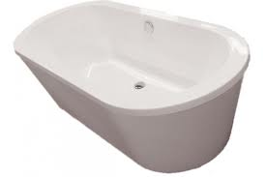
FREE STANDING BATHTUBS
PRAGUE
1800 x 800 x 430
Casablanca
1775 х 780 х 400

Slide 18
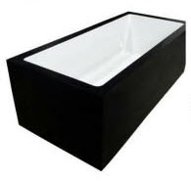
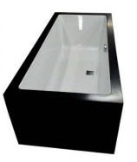
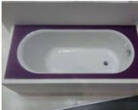
CORRALIT BATHTUBS
Corralit solid surface in your bathroom

Slide 19
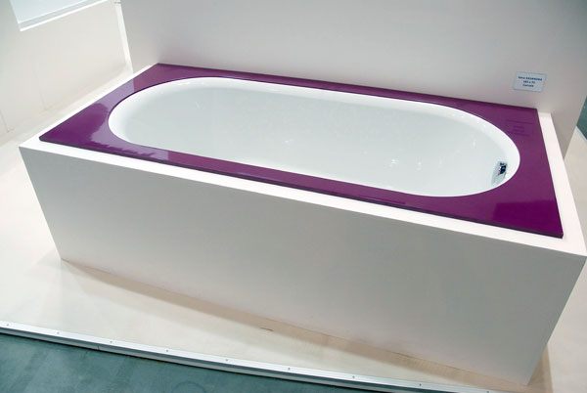
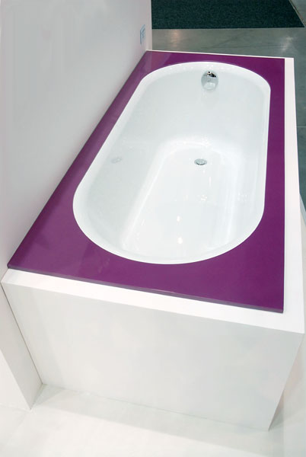
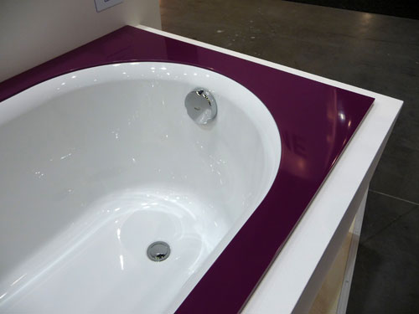
KASANDRA CORRALIT
Kasandra Corralit

Slide 20
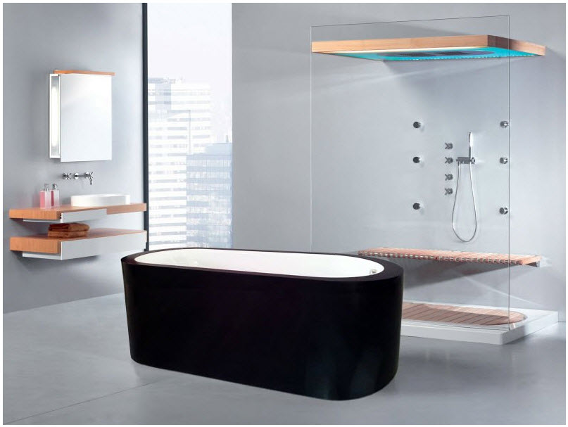

Slide 21
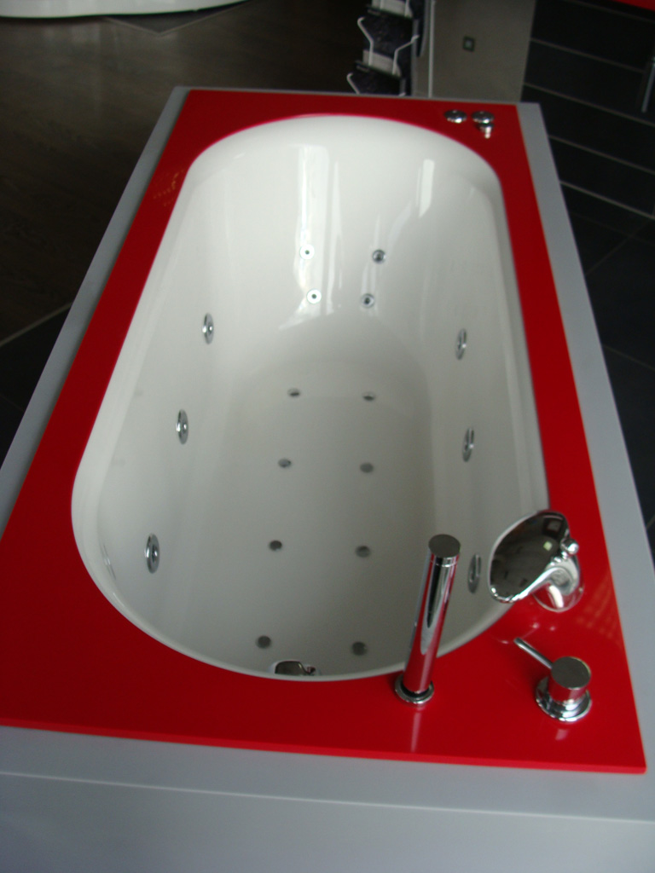

Slide 22
WHIRPOOLS
HYDRO SYSTEM 6 large lateral jets and 4 droplets on the back with a power control.
AIR SYSTEM 8 nozzles on the bottom of the tub, which passes the all throught and creates a bubble bath.
COMBI SYSTEM Combination of AIR and HYDRO massage systems.
All systems are controlled with the pneumatic buttons. Nozzles are available only in chrome. Supplied with disinfection Vitapur. An additional fee for drainage inlet set.

Slide 23
WHIRPOOLS
AIR system
HYDRO system
COMBI system
Jets
Vagnerplast Jacuzzi bathtubs

Slide 24
SHOWER LINE
SHOWER ENCLOSURES
BATH SCREENS
CARINA RV KR DOD JOD PS
CLASSIC One piece Two pieces
CORNER Selena 147 Selena 160
SAGITA RV KR
NEW COLLECTION
From 1.2013 these items will be made only on order
CARINA Walk-In

Slide 25
CARINA
SAGITA
BATH SCREENS
Sagita shower and bath screens are made of aluminum profiles in ELOX color or WHITE.
Carina hinged screens are designed in ELOX. For the production we use a certified secure glass. We also use glass thickness of 5 and 6 mm. Screens can be installed on shower trays or directly on the floor.
Height of shower enclosure is 1900 mm, for bath screens 1480 mm.
Glass is fitted with a protective NANO spray that prevents lime scale and dirt.
We use water resistant screens which complies with the EN norm 14428:06/2005
ATYPICAL SOLUTIONS We are able to produce a variety of Carina and Sagita. Atypical screens are made up to 2000 mm.

Slide 26
SHOWER TRAYS
MARBLE CASTED
NEW ACRYLIC
RONA
KR
RV
Excellent
Square
Rectangular
Quadrant
Casted with marble
Feets are included
RONA RV,KR 80-90-100-120 140-160-170
Feets are included
Box tray with high edge
JUPITER RV 80x80 MERKUR RV 80x80 SATURN KR 90x90 URAN KR 90x90

Slide 27
Joy and comfort into your life, brought to you by
VAGNERPLAST

